Slide 1
PROJECT TITLE
CAPSTONE PROJECT
Presented By:
Kuttithangam .G
9513- Jayaraj Annapackiam CSI College of Engineering
B.E Mechanical Engineering

Slide 2
OUTLINE
Problem Statement
Proposed System/Solution
System Development Approach
Algorithm & Deployment
Result
Conclusion
Future Scope
References

Slide 3
Problem Statement
Background: Heart disease is a leading cause of mortality worldwide, and early detection plays a crucial role in preventing adverse cardiovascular events. Predictive models can aid healthcare professionals in assessing an individual's risk of heart disease and guiding preventive interventions.
Objective: Design and implement a machine learning model to predict the likelihood of heart disease in individuals based on their medical history, clinical measurements, and demographic information.
Key Features:
Demographic Information: Age, gender, and other relevant demographic factors.
Medical History: Family history of heart disease, presence of comorbidities (e.g., diabetes, hypertension), and previous cardiovascular events.
Clinical Measurements: Blood pressure, cholesterol levels (LDL, HDL), blood sugar levels, electrocardiogram (ECG) readings, and other diagnostic tests.
Lifestyle Factors: Smoking status, physical activity level, dietary habits, and alcohol consumption.

Slide 4
Proposed Solution
. Data Collection:
Gather a comprehensive dataset containing relevant medical, clinical, and demographic information of patients, including features such as age, gender, blood pressure, cholesterol levels, blood sugar levels, ECG readings, family history of heart disease, lifestyle factors (smoking, physical activity, diet), and previous medical history.
2. Data Preprocessing:
Clean the data by handling missing values, outliers, and inconsistencies.
Encode categorical variables using techniques like one-hot encoding or label encoding.
Perform feature scaling to ensure uniformity in feature values (e.g., normalization or standardization).
3. Exploratory Data Analysis (EDA):
Conduct exploratory data analysis to understand feature distributions, correlations, and identify potential patterns or insights related to heart disease risk factors.
Visualize data using plots such as histograms, box plots, correlation matrices, and scatter plots.
4. Feature Selection and Engineering:
Select relevant features based on domain knowledge, statistical analysis, and feature importance techniques (e.g., correlation analysis, chi-squared test, mutual information).
Engineer new features or transformations if beneficial (e.g., BMI calculation, age group categorization).
5. Model Selection:
Choose appropriate machine learning algorithms for binary classification tasks, such as logistic regression, random forest, support vector machines (SVM), gradient boosting machines (GBM), or artificial neural networks (ANN).
Consider ensemble methods for improved predictive performance and model robustness.

Slide 5
System Approach
Data Collection and Preprocessing:
Gather a dataset containing relevant features such as age, gender, blood pressure, cholesterol levels, blood sugar levels, ECG readings, family history of heart disease, lifestyle factors, and medical history.
Preprocess the data by handling missing values, outliers, encoding categorical variables, and performing feature scaling or normalization.
Hyperparameter Tuning and Optimization:
Optimize model hyperparameters using techniques like grid search, randomized search, or Bayesian optimization to improve predictive accuracy.
Model Deployment:
Deploy the trained model into a production environment where it can accept new patient data and generate predictions.
Develop APIs or interfaces for seamless integration with healthcare systems or applications.
Continuous Monitoring and Maintenance:
Implement monitoring mechanisms to track model performance, detect drifts, and ensure predictive accuracy over time.
Regularly update and retrain the model using new data to adapt to evolving patterns and maintain efficacy.
Interpretability and Explainability:
Ensure the model's interpretability and explainability using techniques such as feature importance plots, SHAP (SHapley Additive exPlanations) values, or LIME (Local Interpretable Model-agnostic Explanations) for individual predictions.

Slide 6
Algorithm & Deployment
ALGORITHM
Data Preprocessing:
Clean the data, handle missing values, encode categorical variables.
Scale or normalize numerical features.
Feature Selection:
Select relevant features using techniques like correlation analysis, feature importance, or domain knowledge.
Model Training:
Split data into training and testing sets.
Train selected algorithms using the training data.
Model Evaluation:
Evaluate model performance using metrics like accuracy, precision, recall, F1 score, and ROC-AUC curve.

Slide 7
deployment
Model Deployment:
Deploy the trained model in a production environment using frameworks like Flask
For cloud deployment, use services like AWS Lambda, Google Cloud Functions, or Azure Functions.
API Development:
Develop APIs for the model to accept input data and generate predictions.
Ensure API security using authentication and authorization mechanisms.
Scalability:
Design the deployment architecture to handle multiple concurrent requests efficiently.
Utilize containerization (e.g., Docker) and container orchestration tools (e.g., Kubernetes) for scalability.
Monitoring and Logging:
Implement monitoring for model performance, system health, and usage metrics.
Use logging frameworks (e.g., ELK stack) for tracking errors and debugging.
Continuous Integration/Continuous Deployment (CI/CD):
Set up CI/CD pipelines for automated testing, deployment, and version control.
Ensure seamless updates and maintenance of the deployed model.
Compliance and Data Security:
Adhere to regulatory compliance (e.g., GDPR, HIPAA) for handling sensitive medical data.
Implement data encryption, access controls, and audit logging for data security.
User Interface (UI):
Develop a user-friendly interface for inputting patient data and displaying prediction results.
Consider visualization tools (e.g., Matplotlib, Plotly) for interactive data visualization.

Slide 8

Result

Slide 9
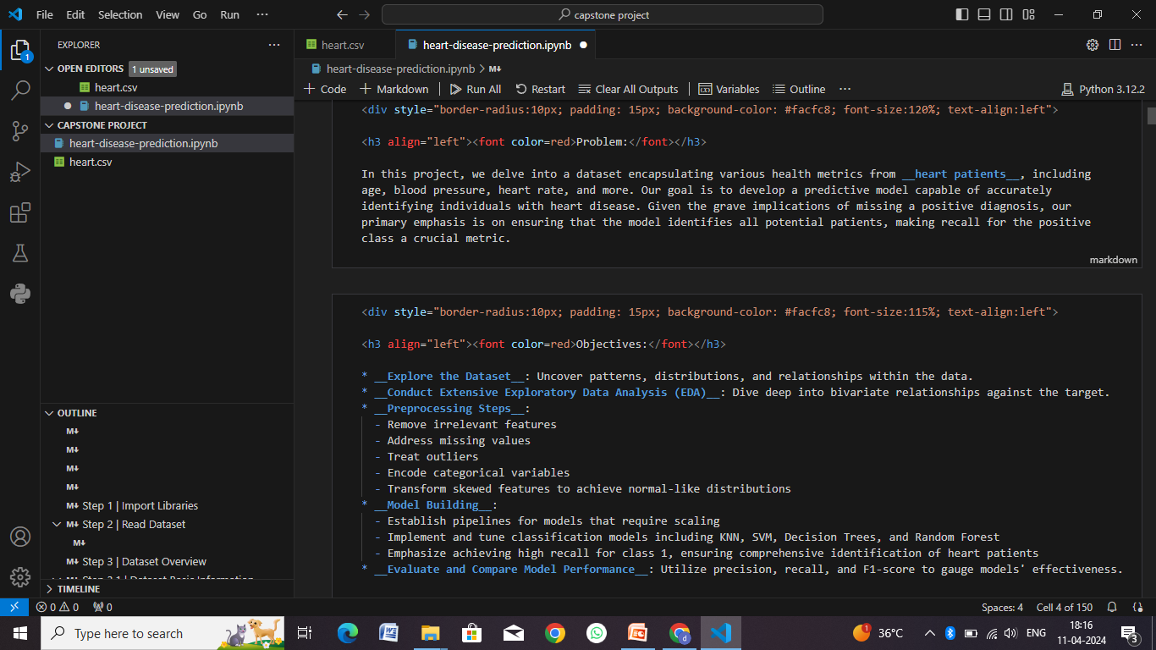

Slide 10
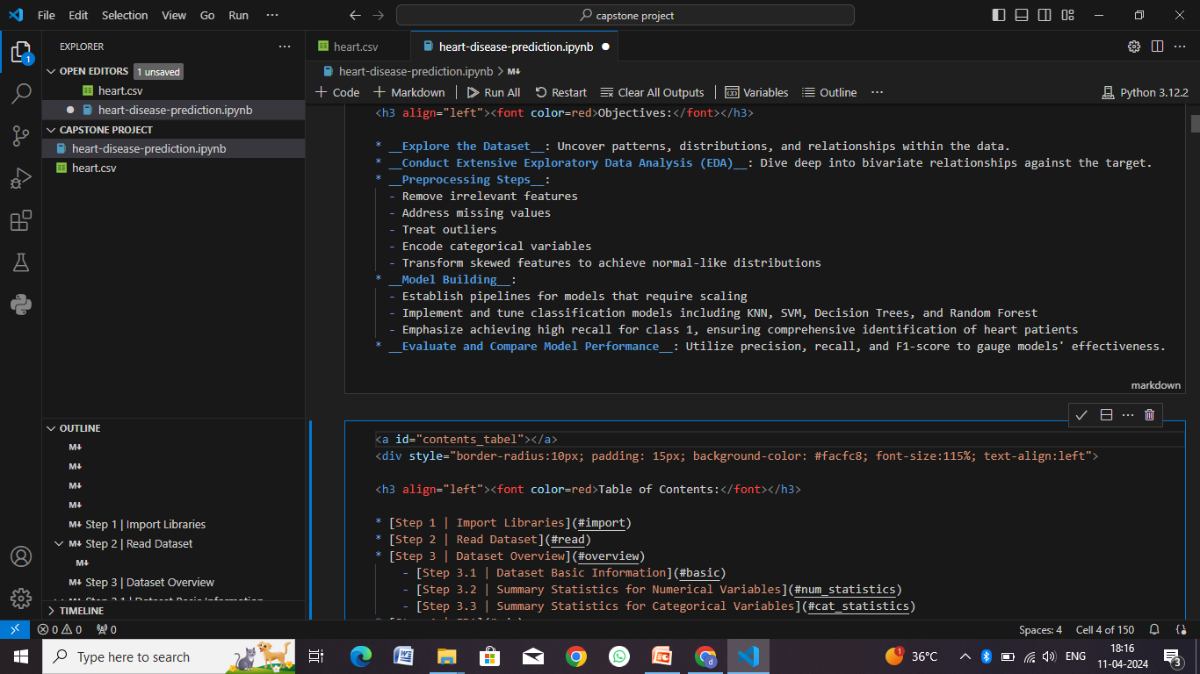

Slide 11
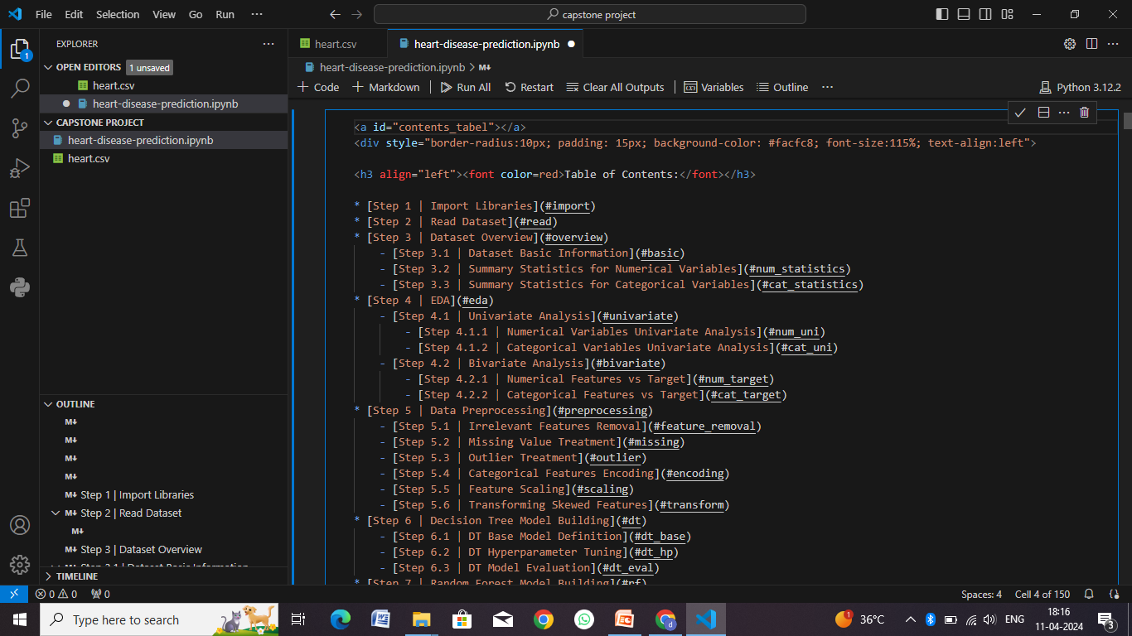

Slide 12
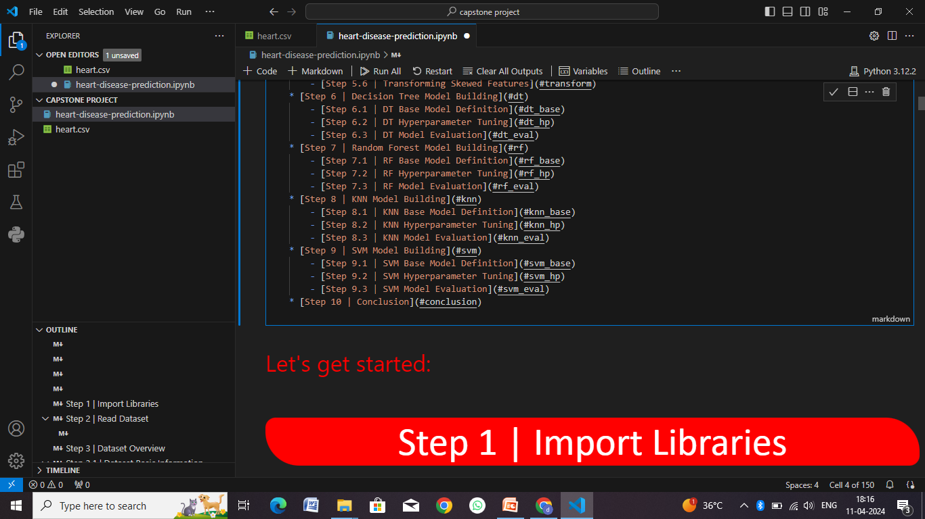

Slide 13
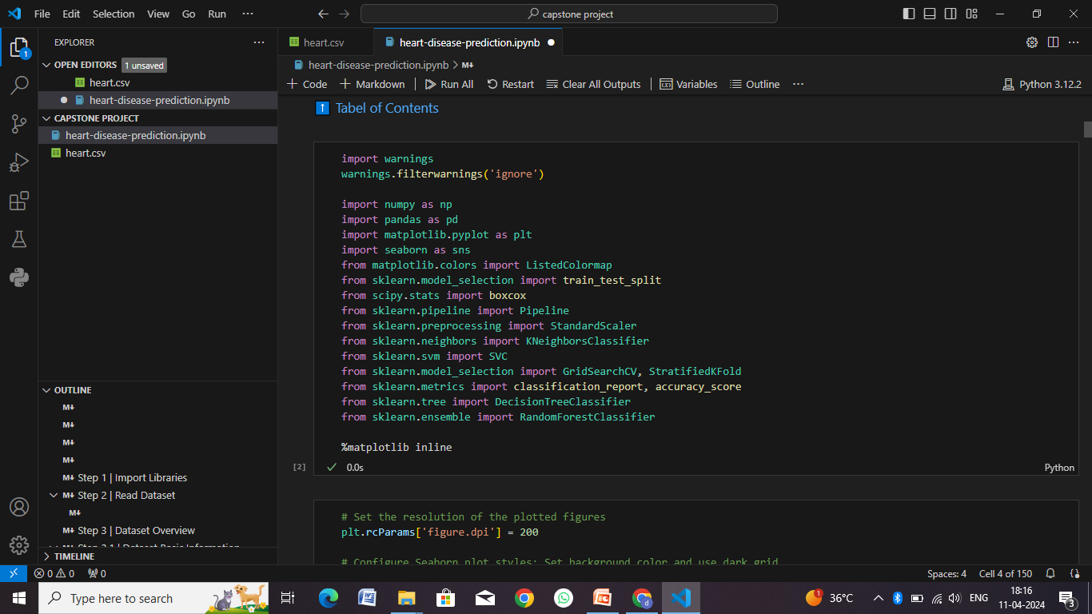

Slide 14
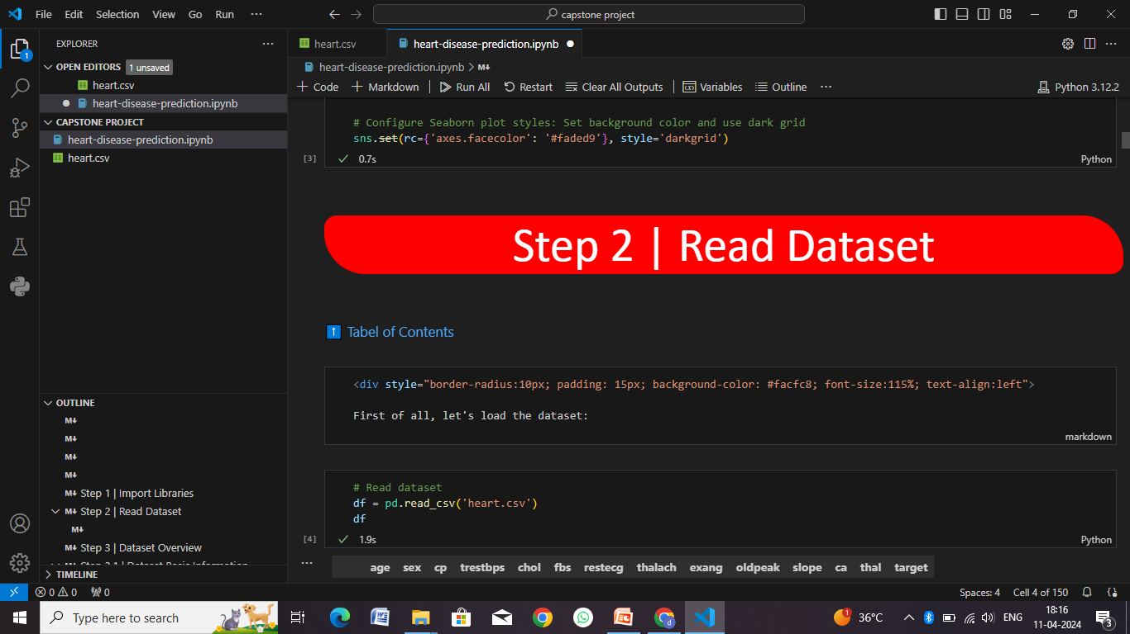

Slide 15
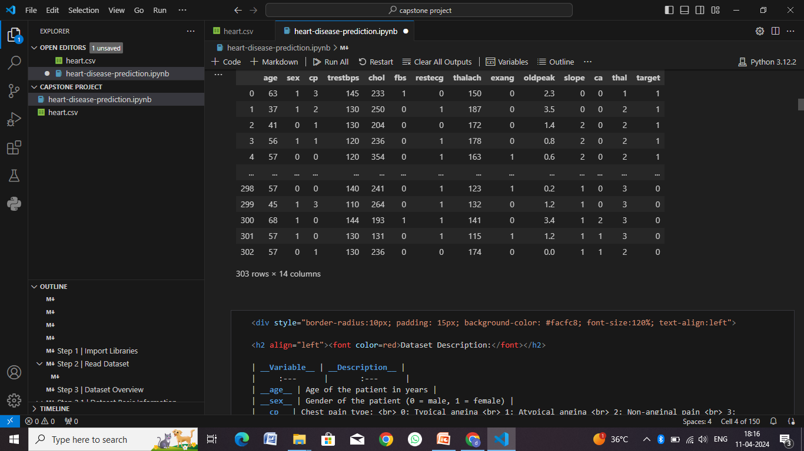

Slide 16
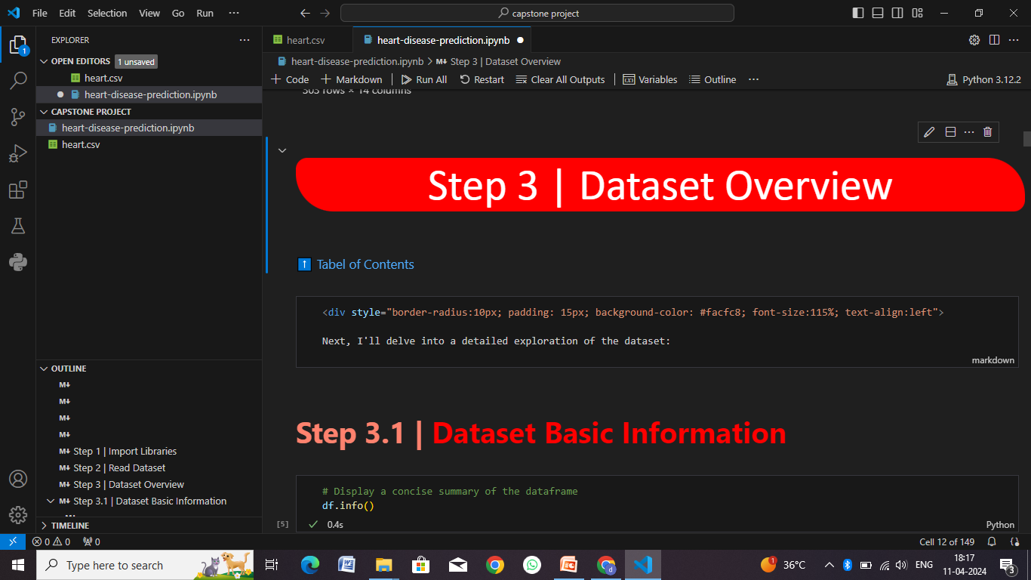

Slide 17
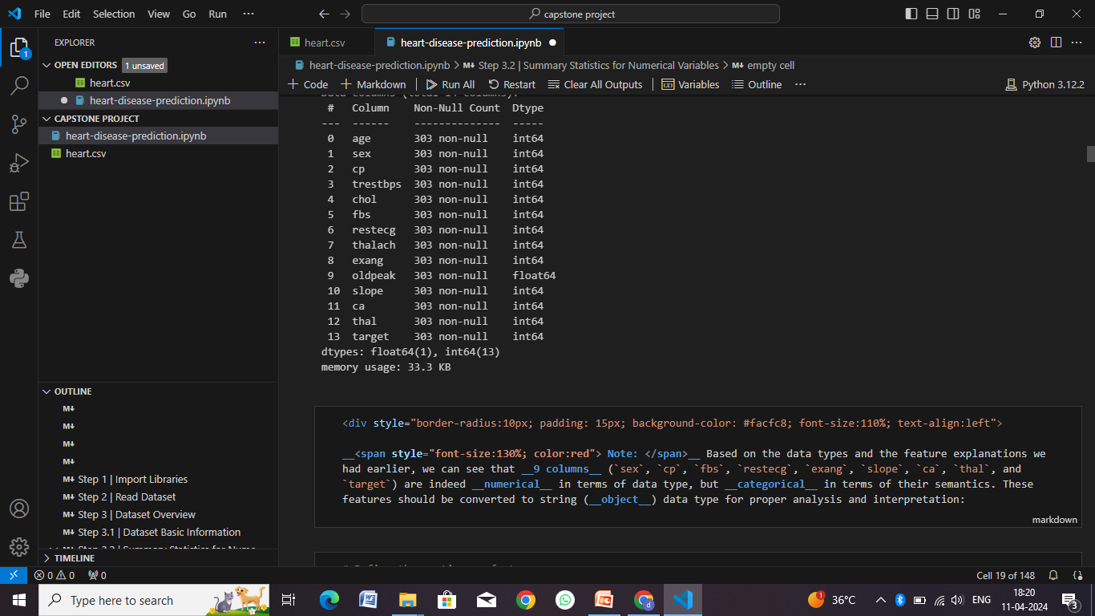

Slide 18
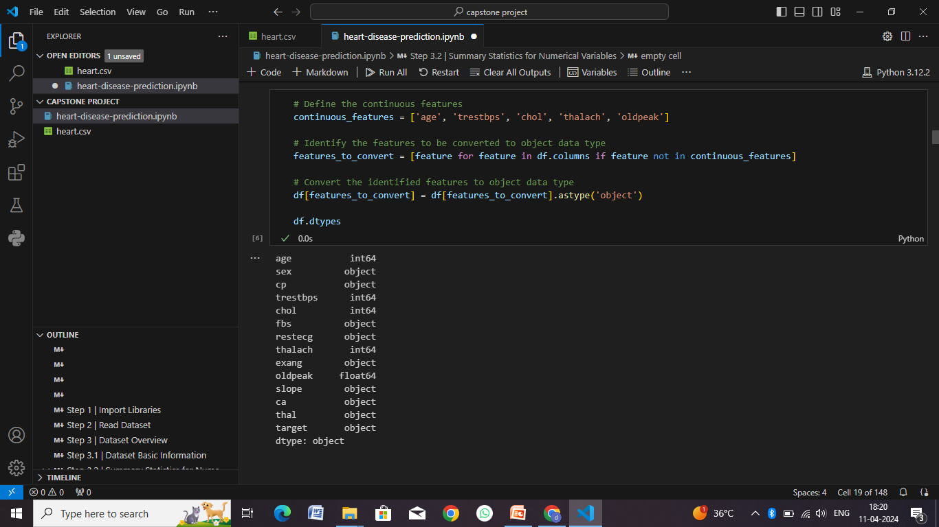

Slide 19
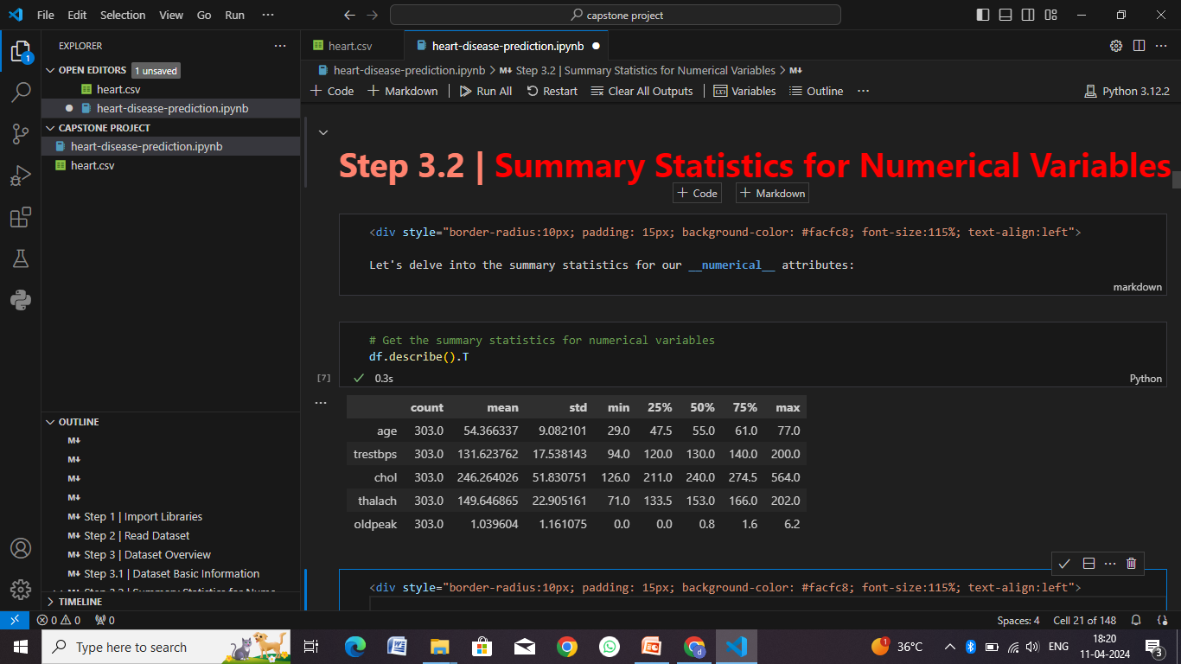

Slide 20
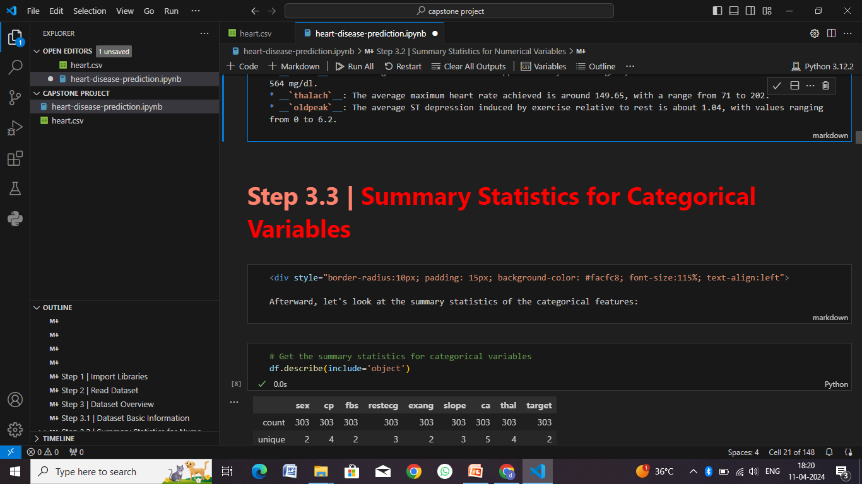

Slide 21
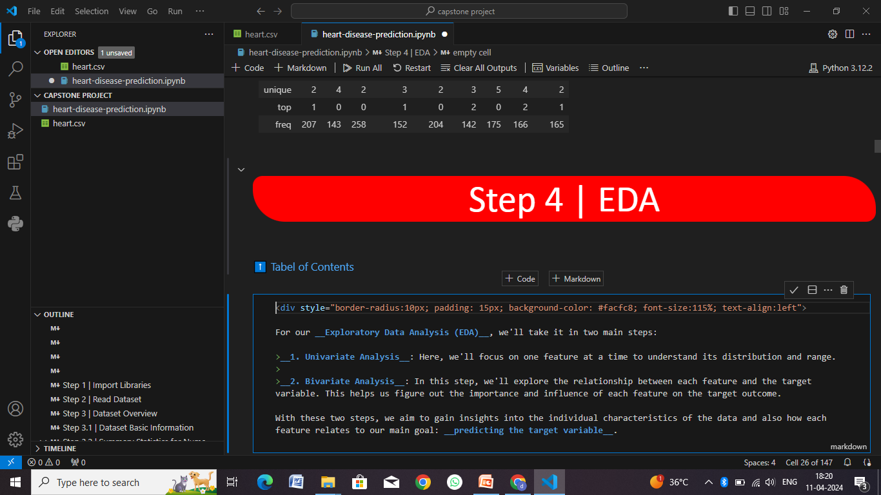

Slide 22
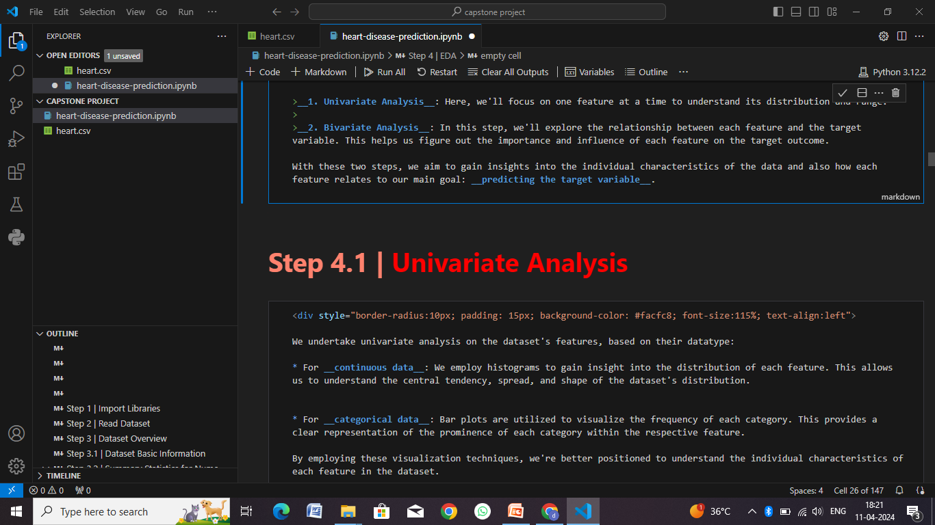

Slide 23
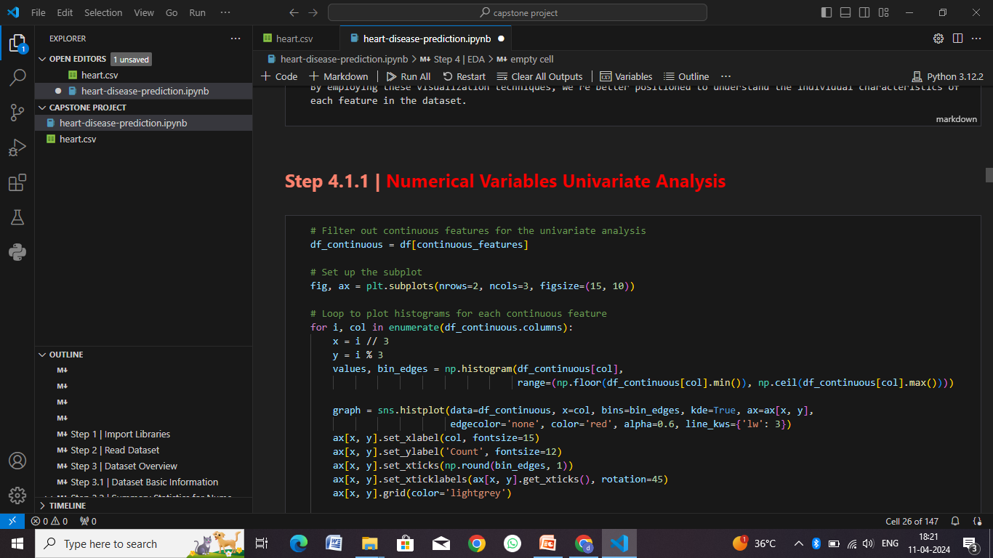

Slide 24
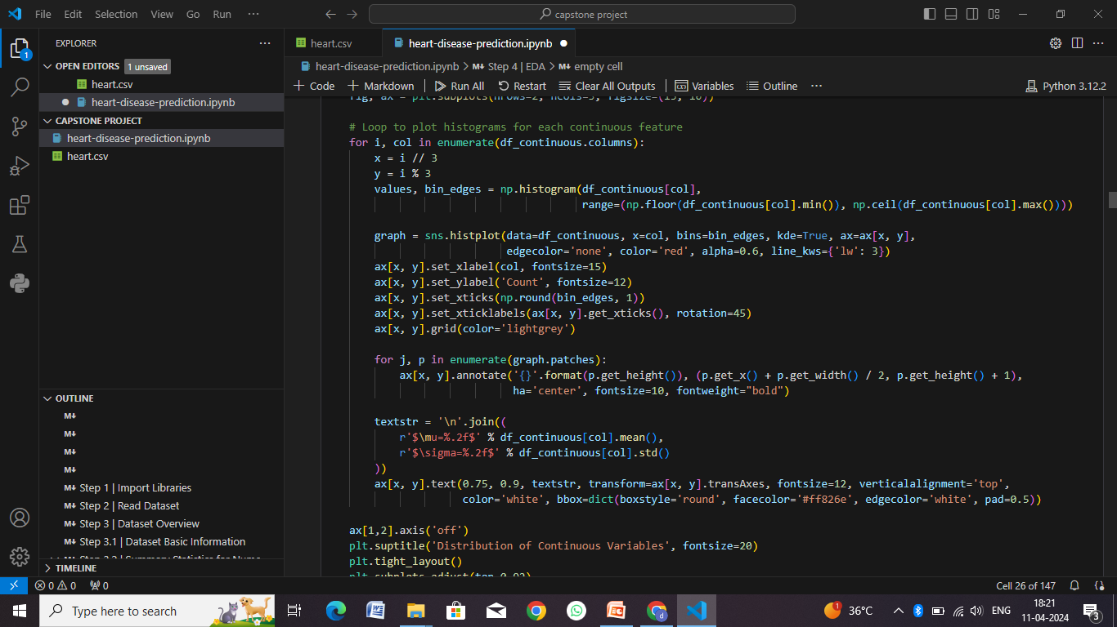

Slide 25
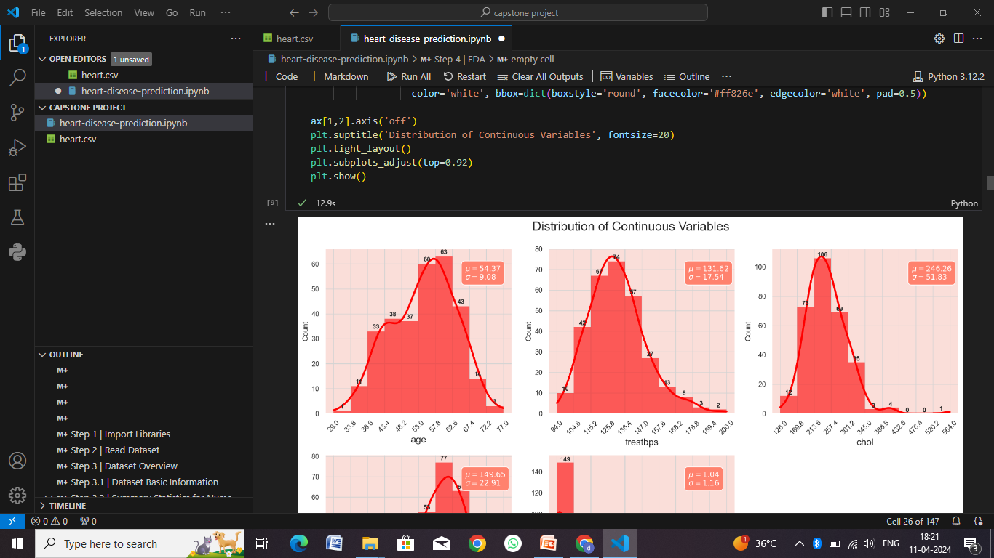

Slide 26
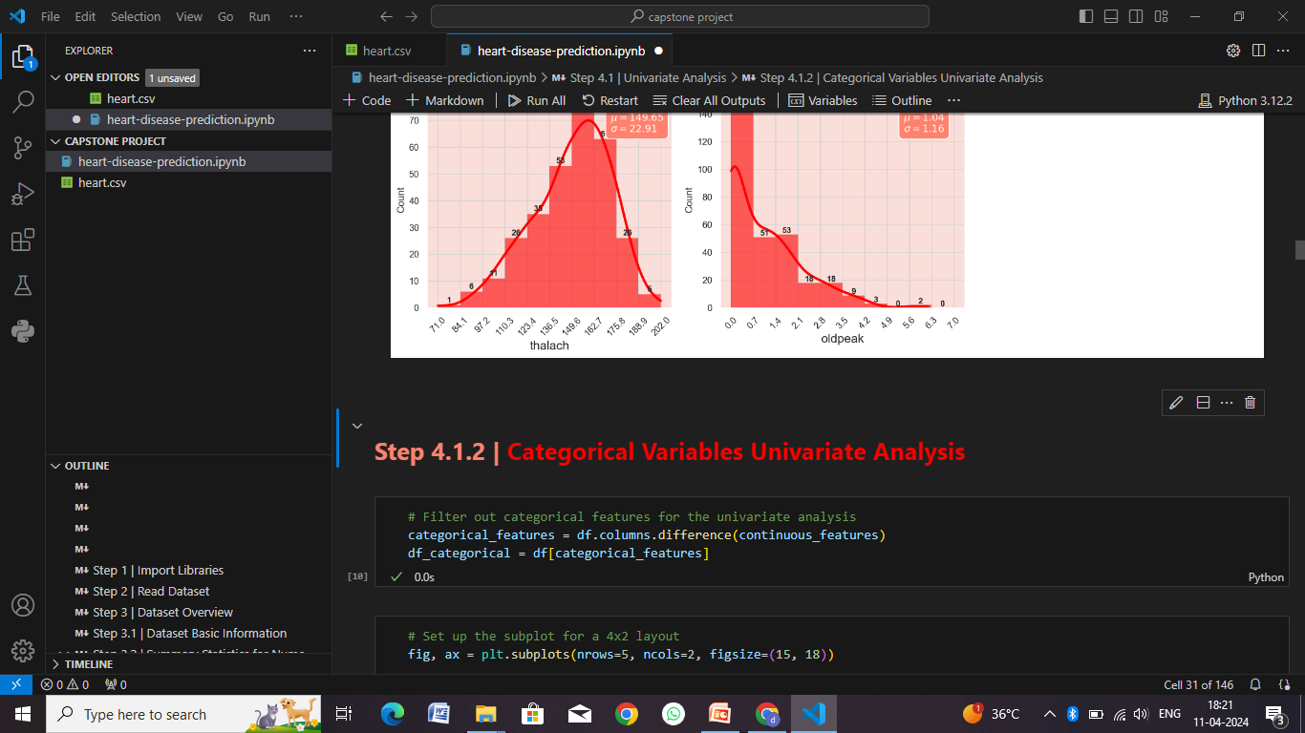

Slide 27
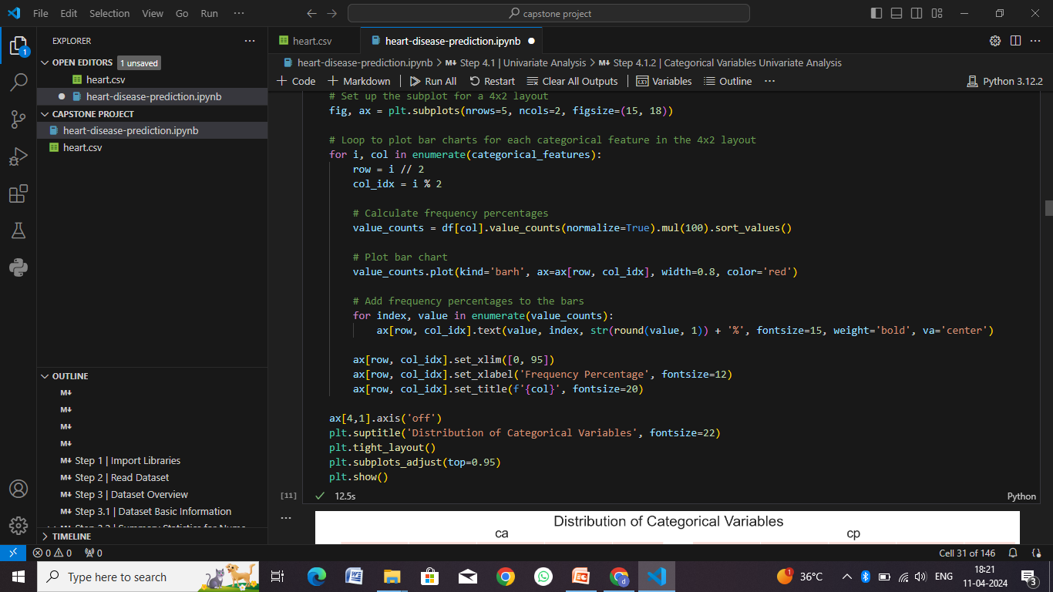

Slide 28
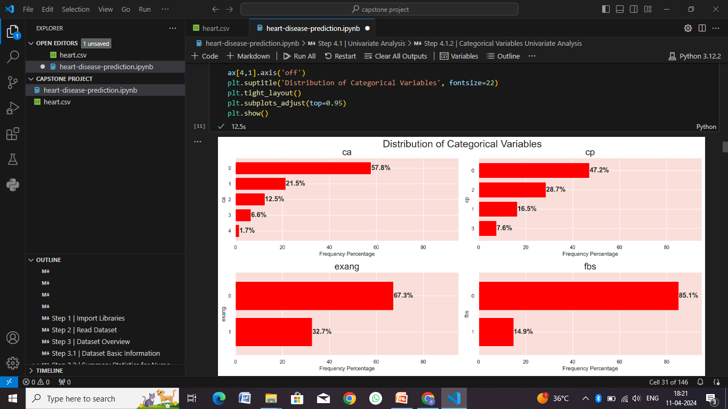

Slide 29
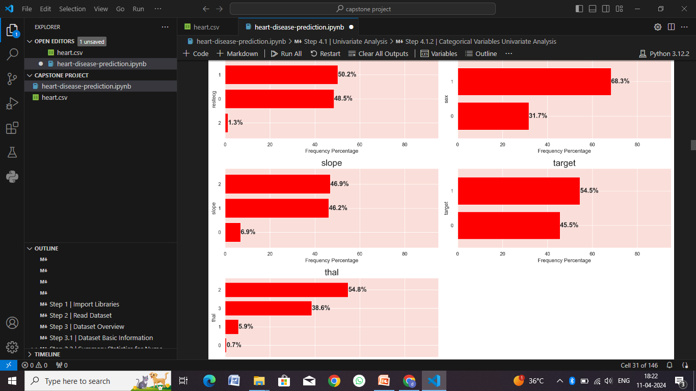

Slide 30
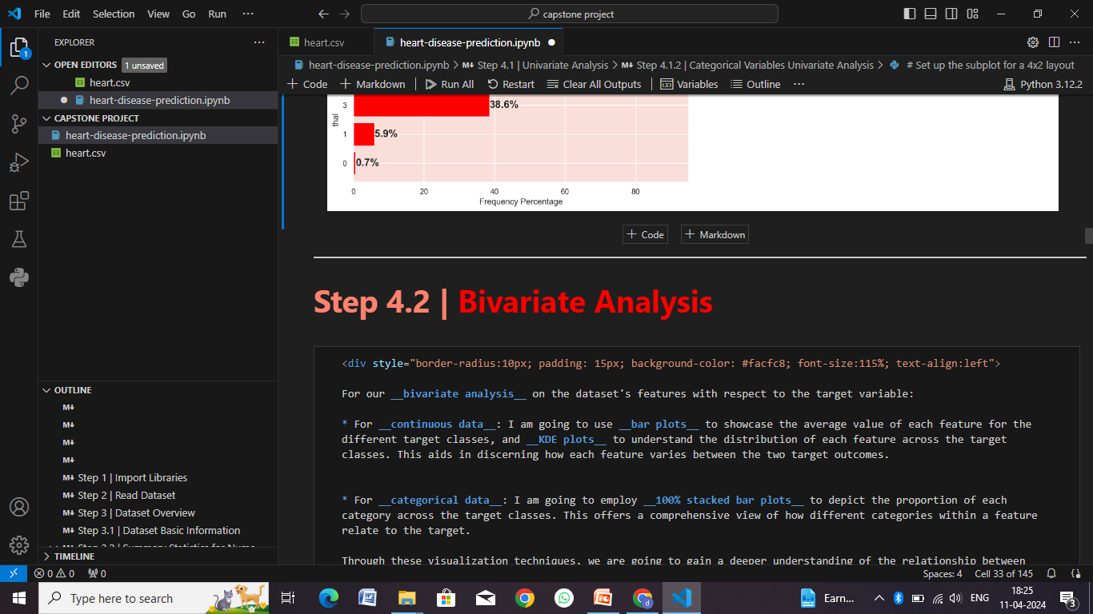

Slide 31
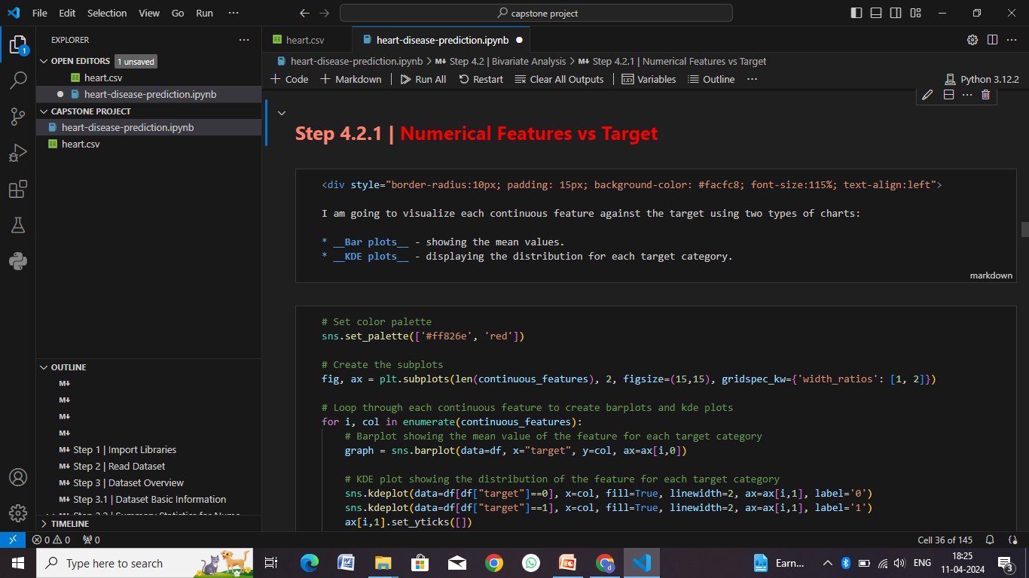

Slide 32
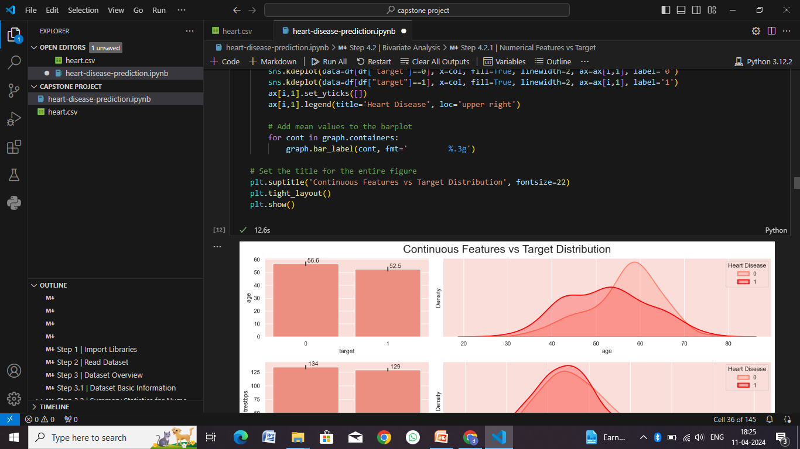

Slide 33
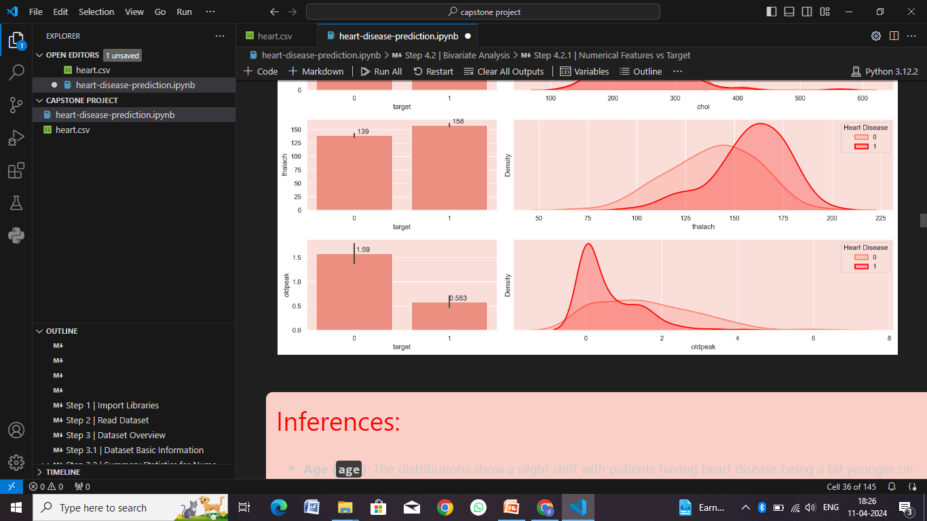

Slide 34
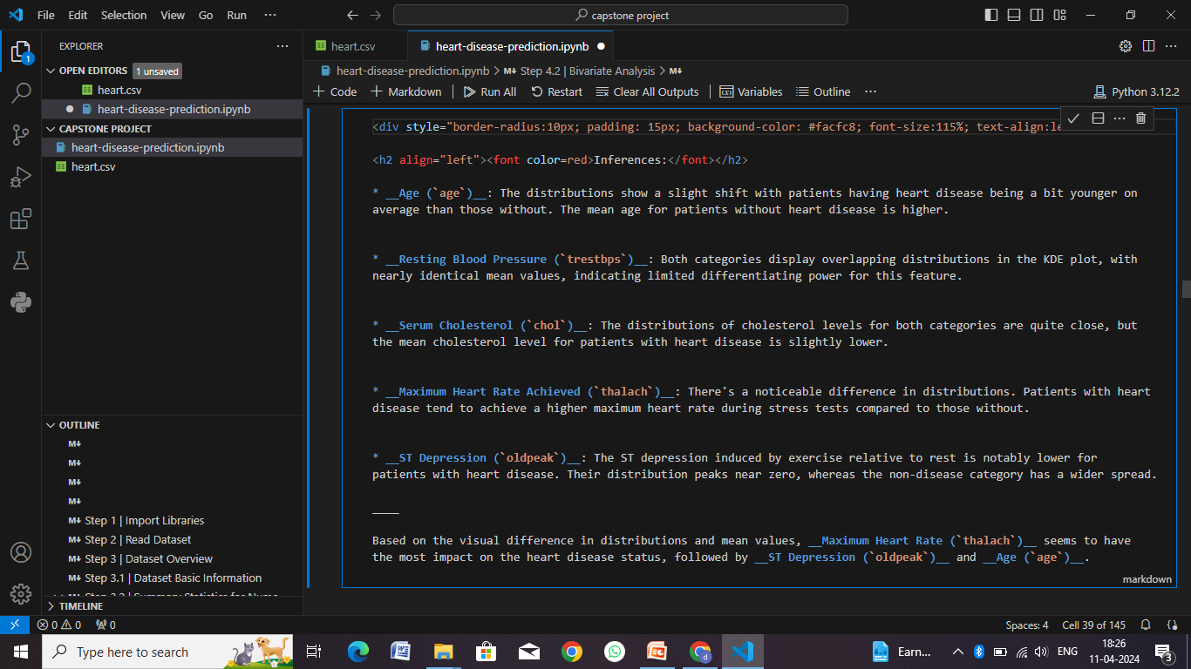

Slide 35
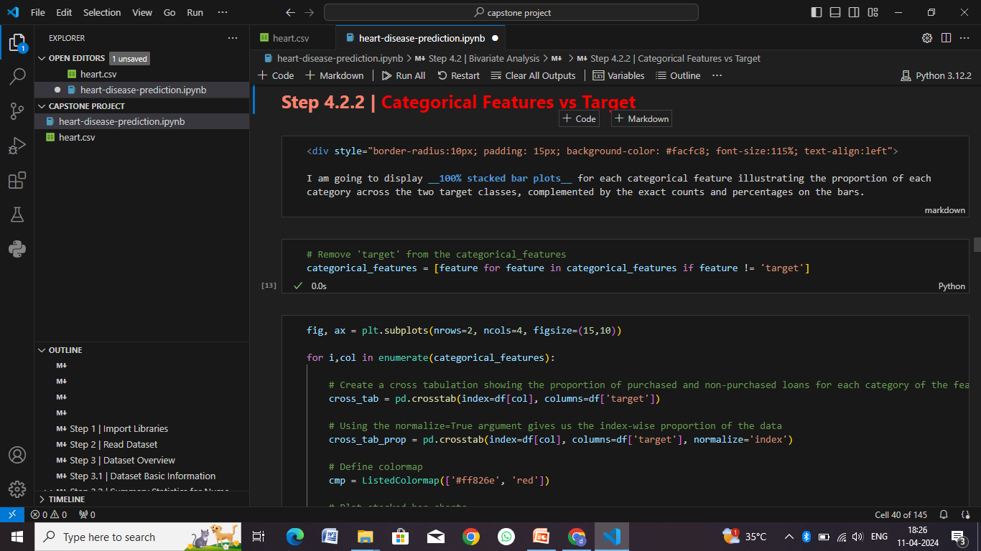

Slide 36
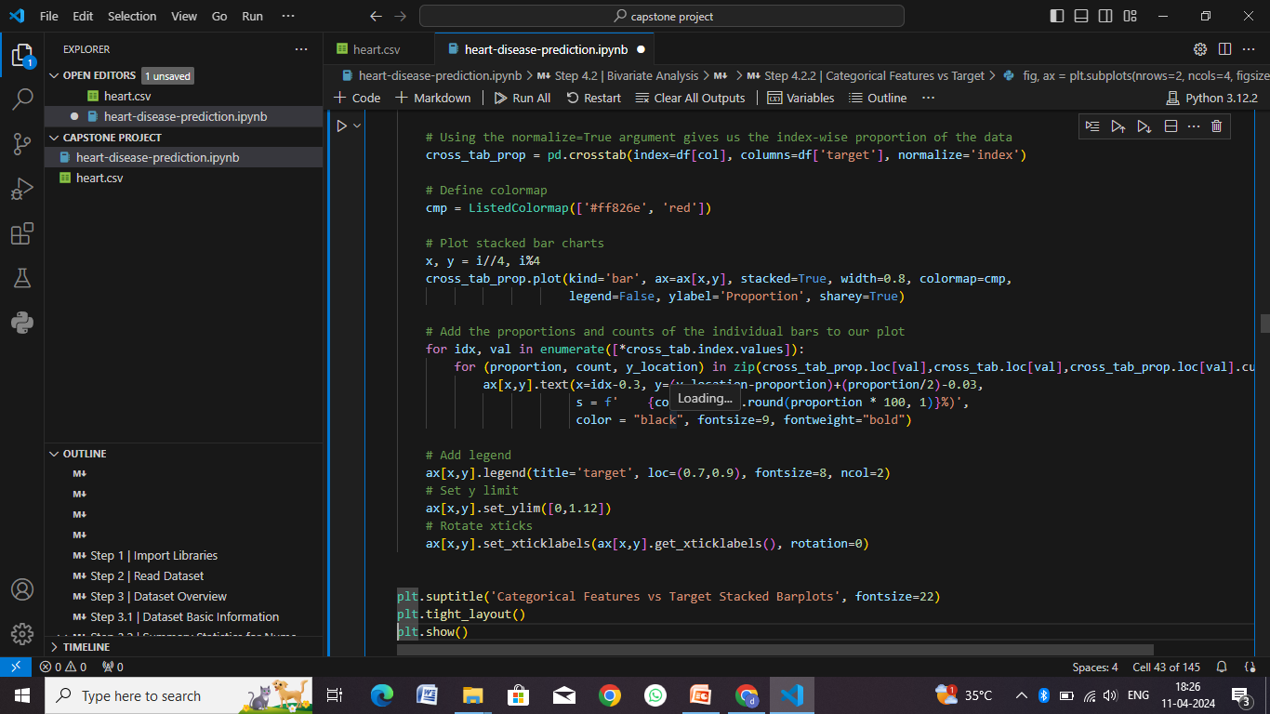

Slide 37
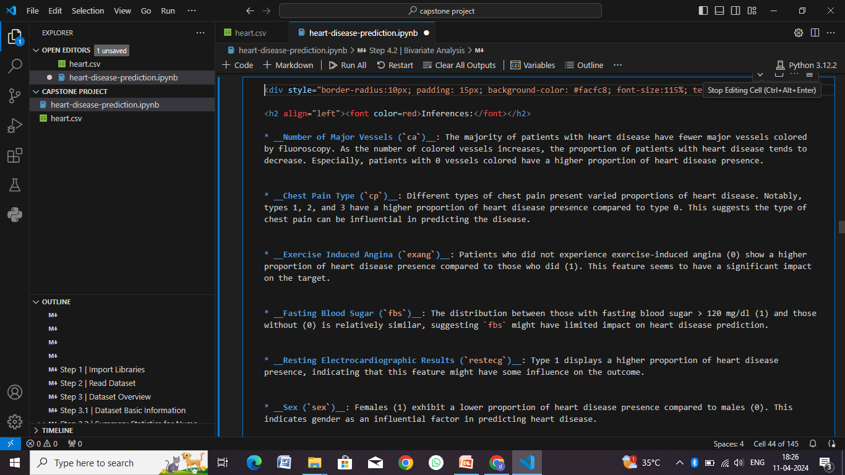

Slide 38
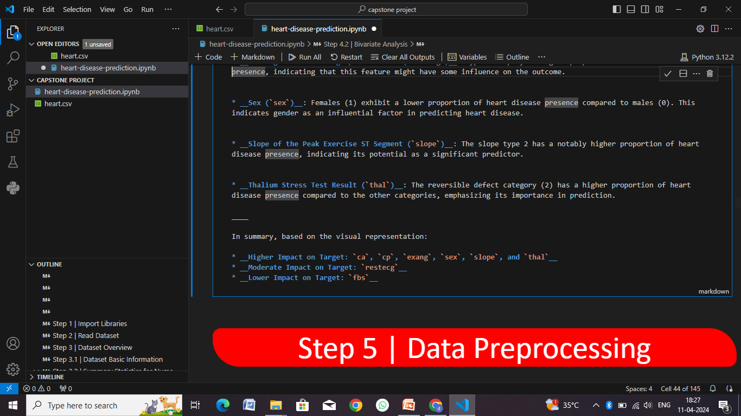

Slide 39
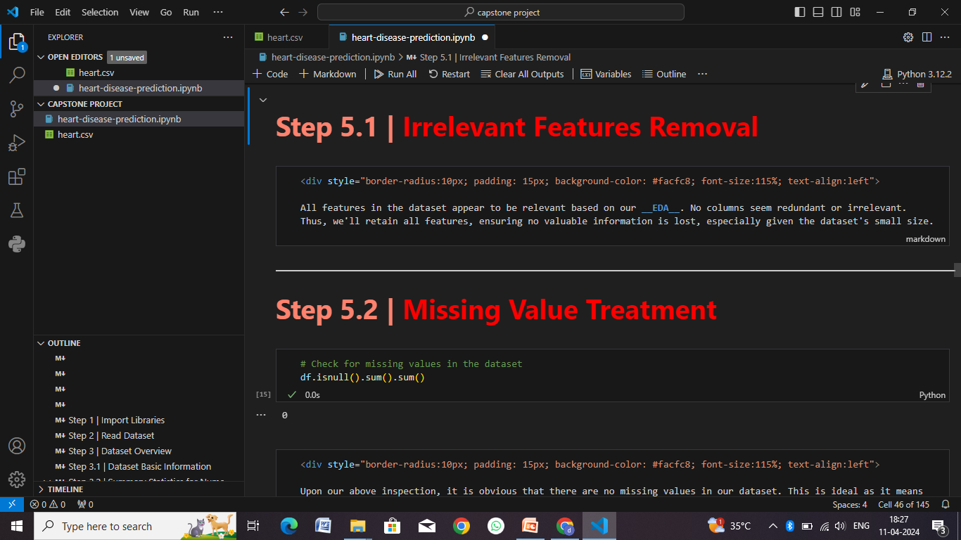

Slide 40
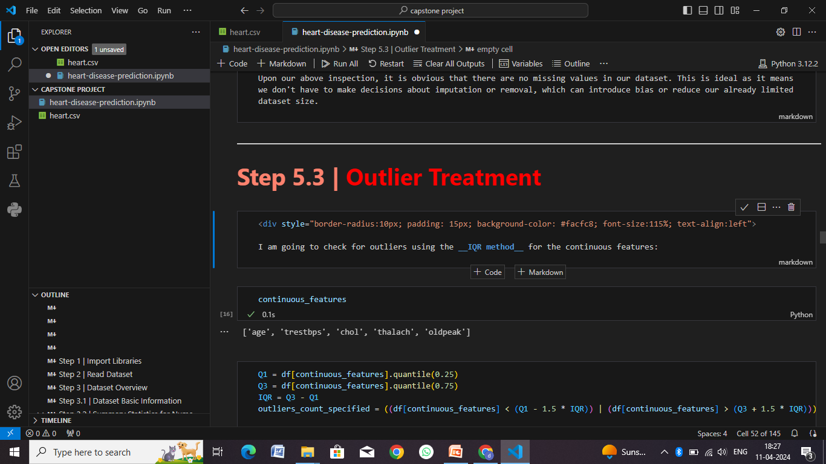

Slide 41
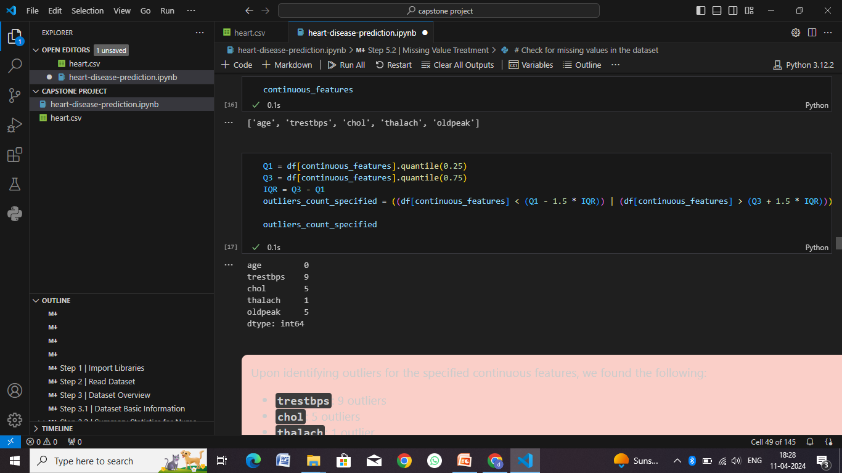

Slide 42
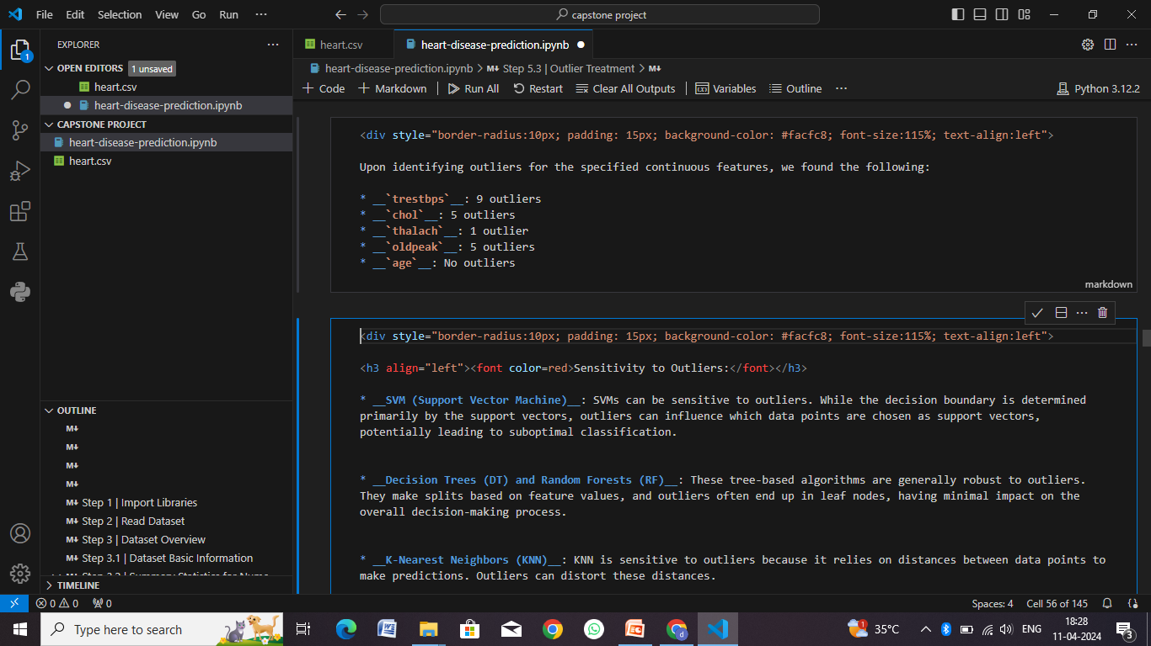

Slide 43
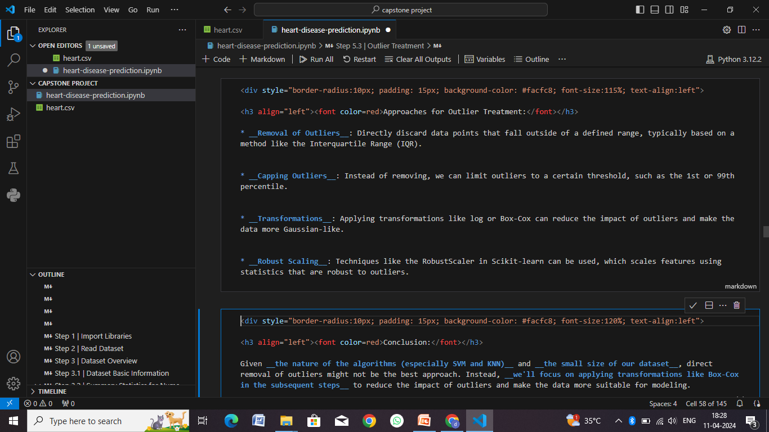

Slide 44
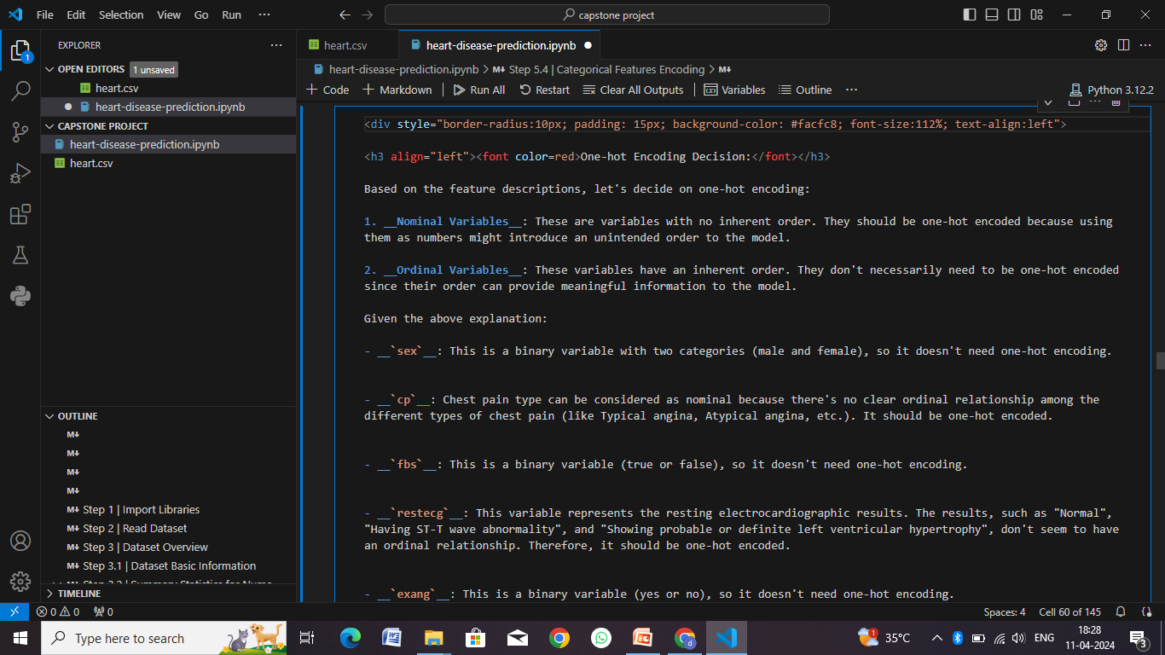

Slide 45
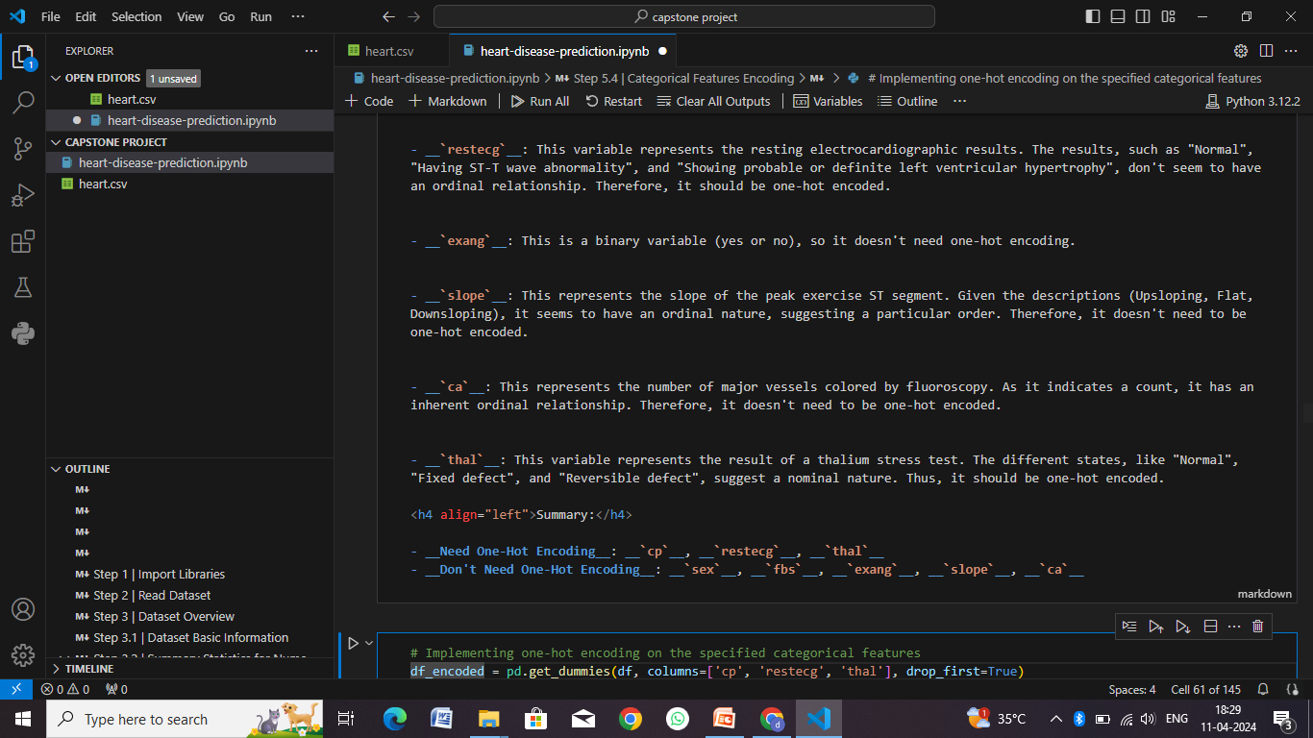

Slide 46
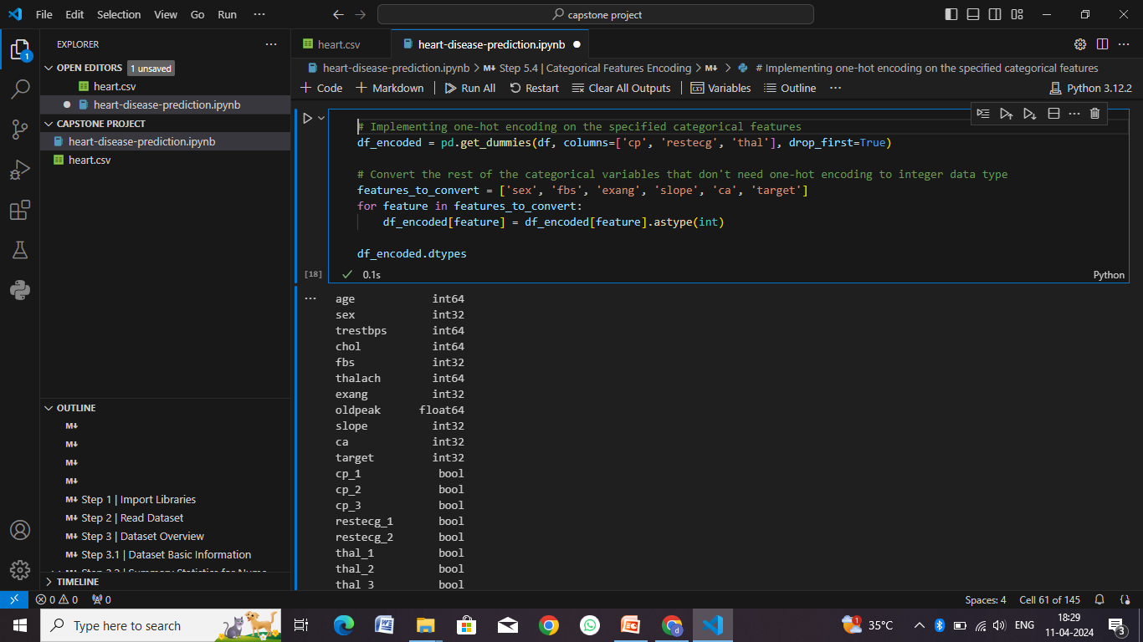

Slide 47
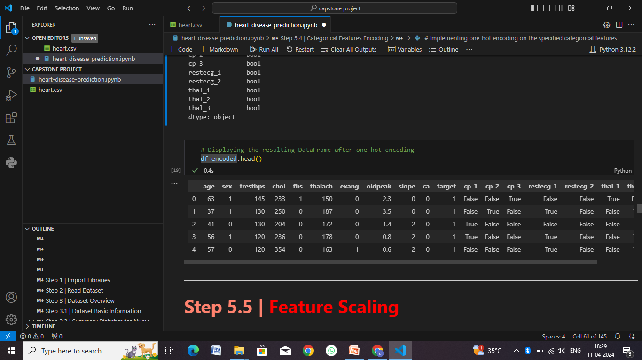

Slide 48
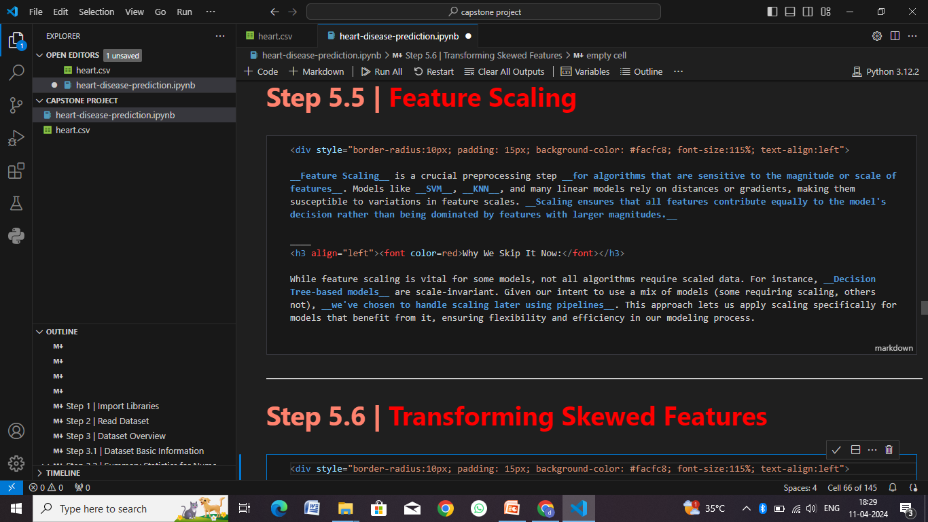

Slide 49
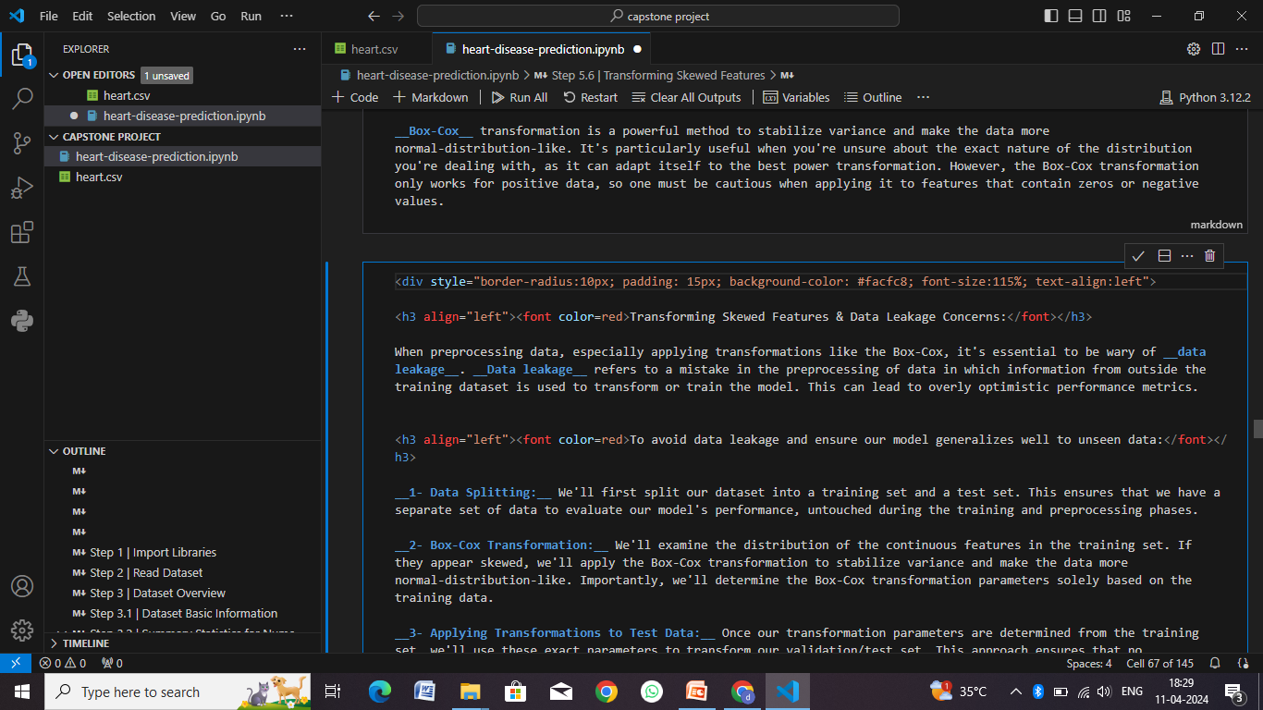

Slide 50
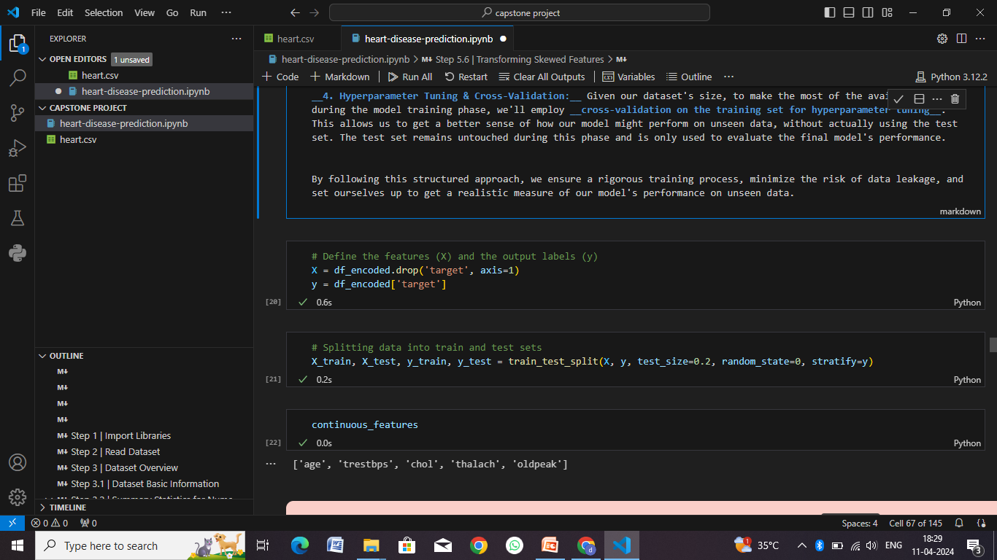

Slide 51
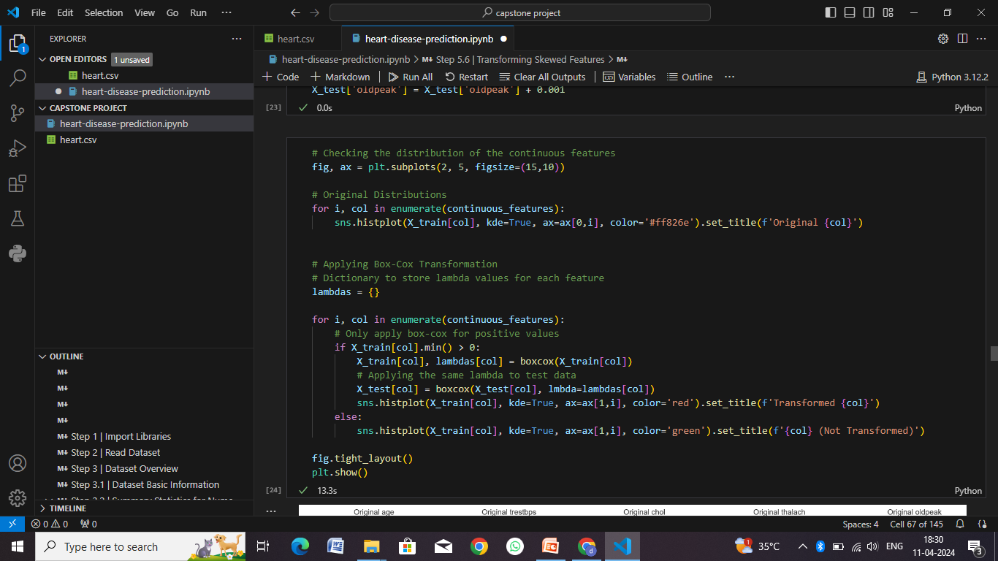

Slide 52
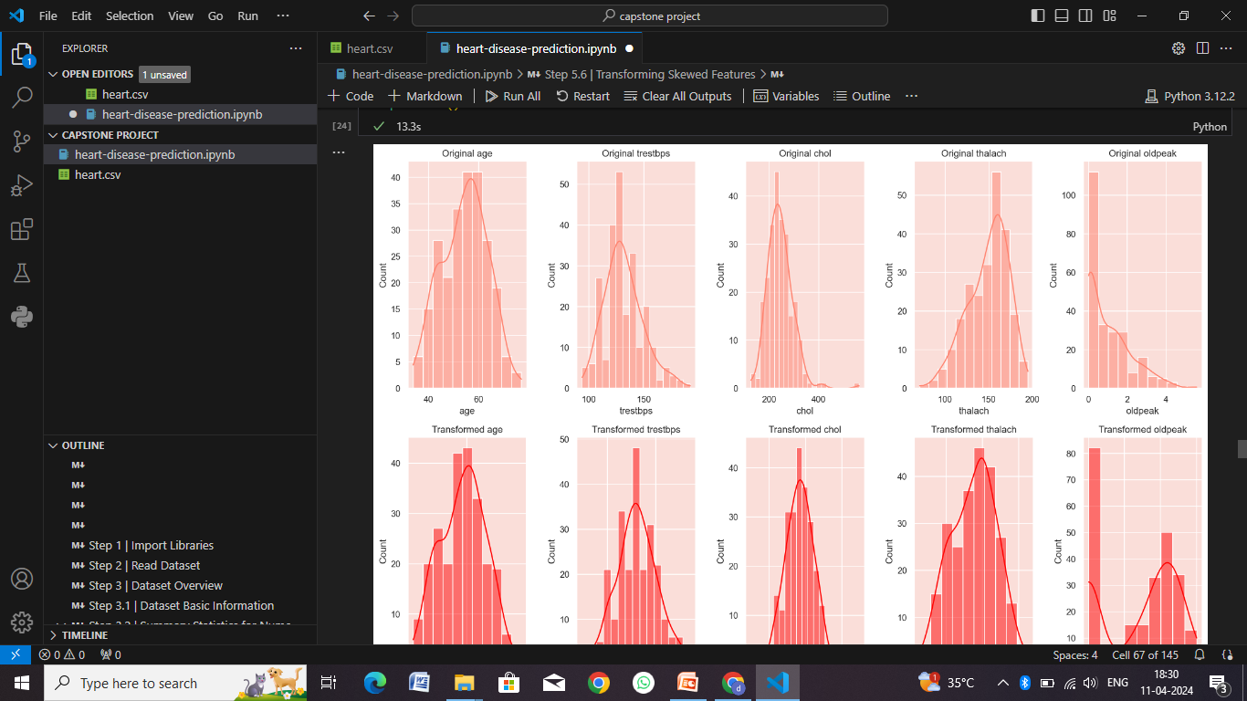

Slide 53
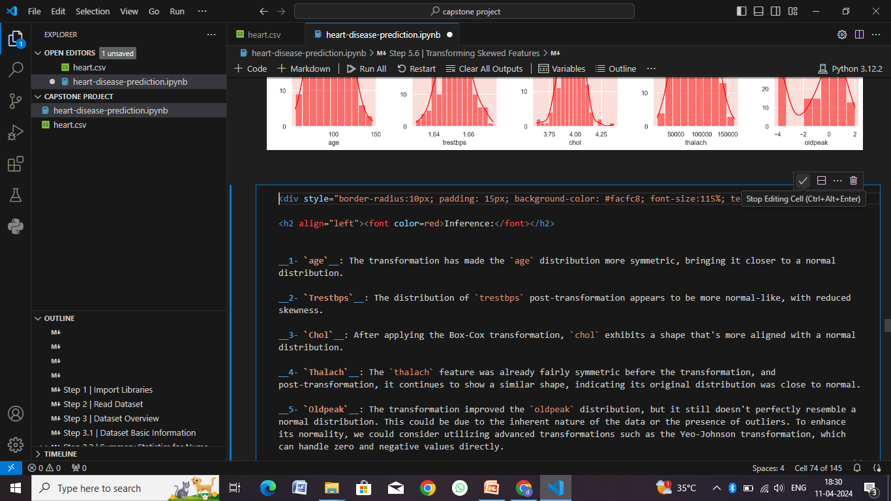

Slide 54
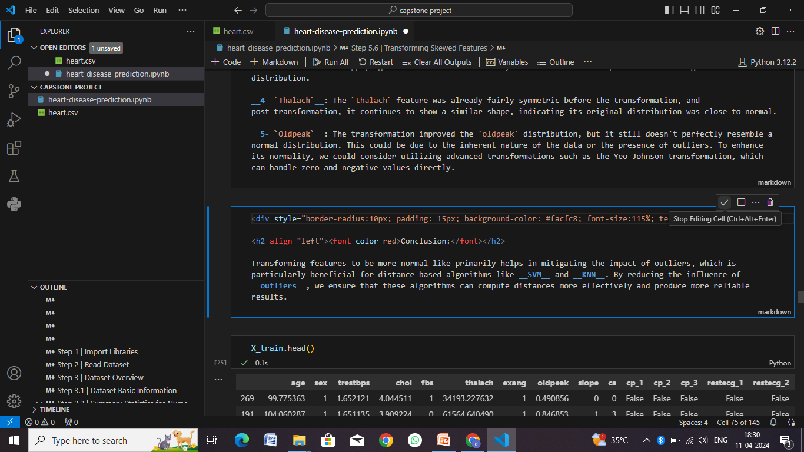

Slide 55
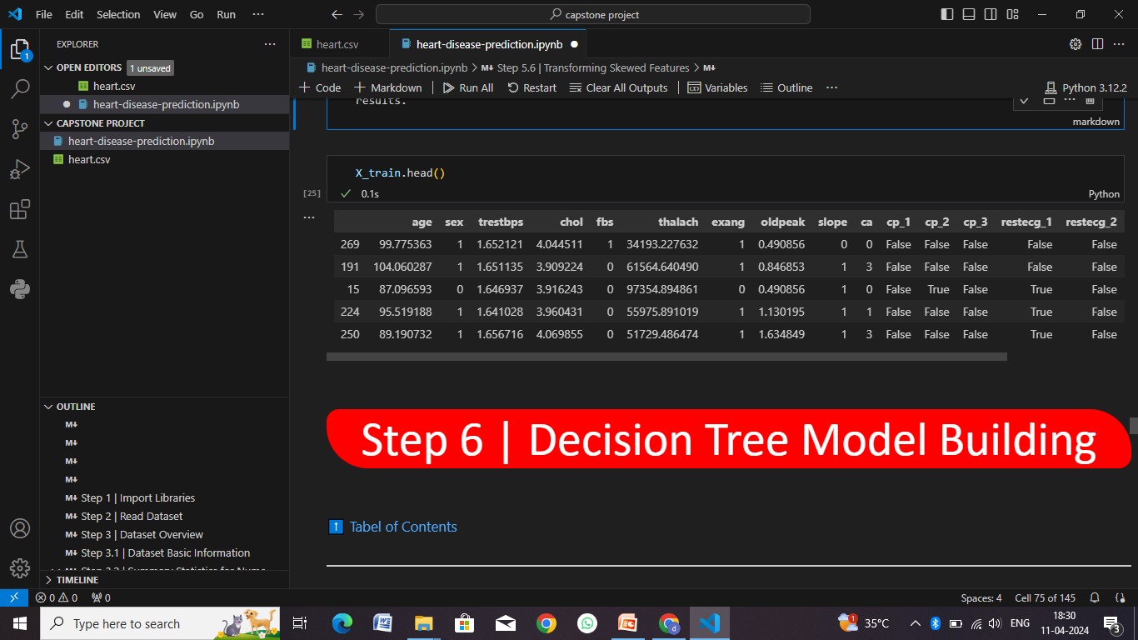

Slide 56
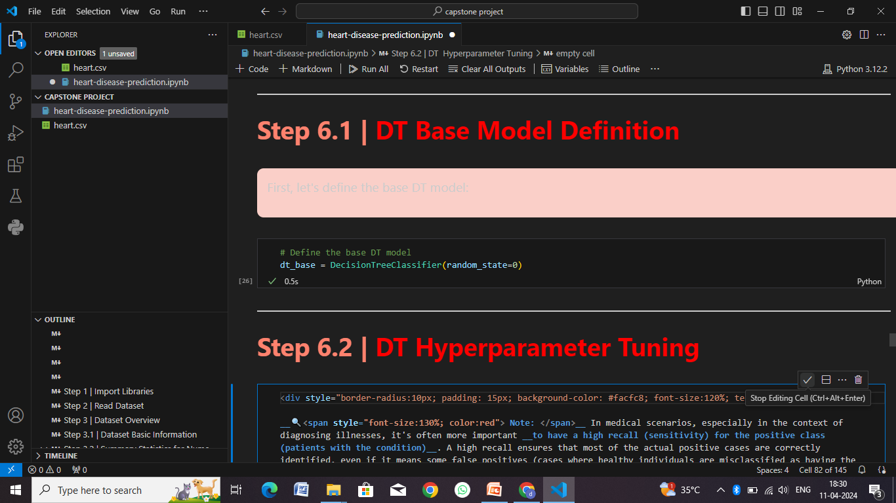

Slide 57
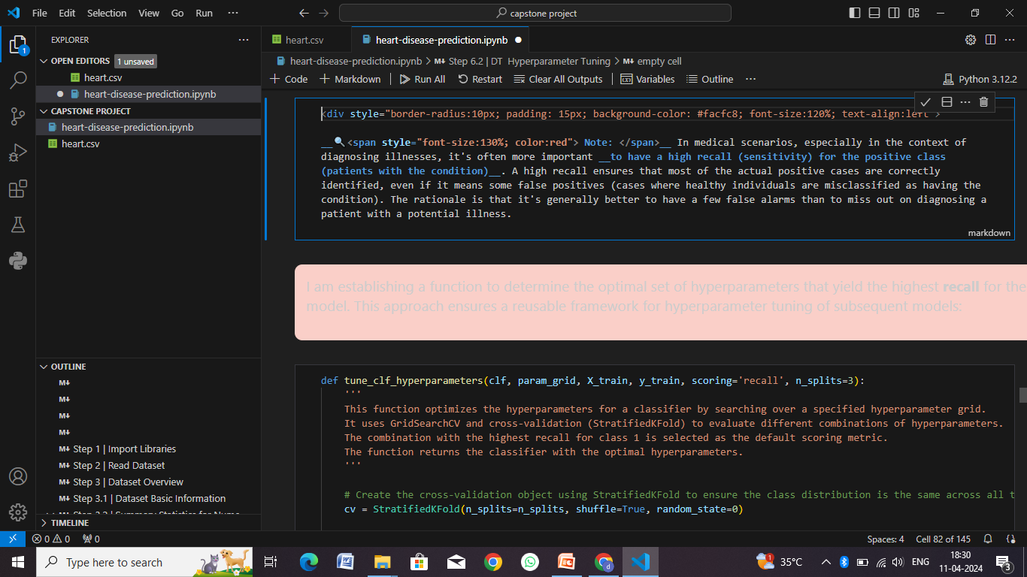

Slide 58
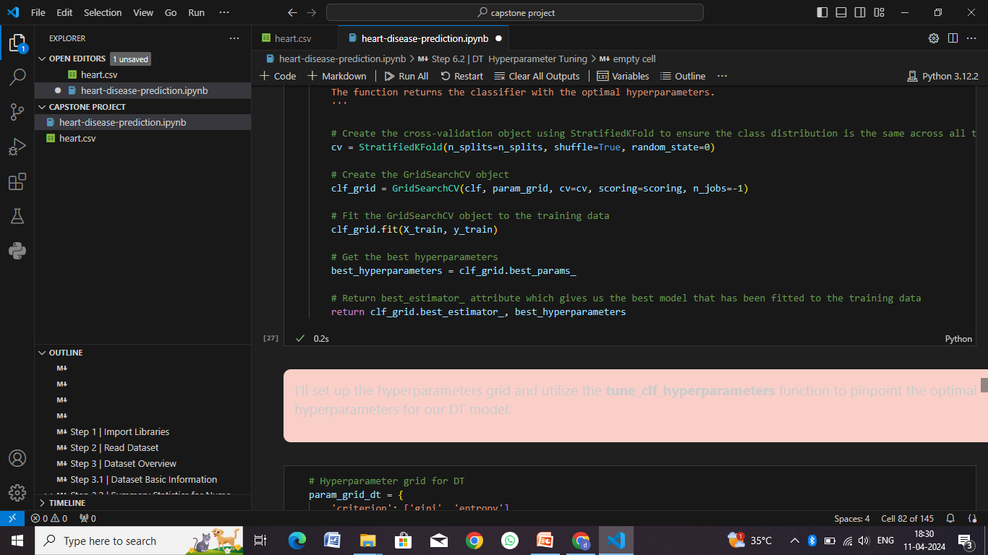

Slide 59


Slide 60


Slide 61


Slide 62


Slide 63


Slide 64


Slide 65


Slide 66


Slide 67


Slide 68


Slide 69


Slide 70


Slide 71


Slide 72


Slide 73


Slide 74


Slide 75


Slide 76


Slide 77


Slide 78
Conclusion
The heart disease prediction system is an essential tool in modern healthcare, leveraging advanced machine learning techniques to improve early detection, risk assessment, and intervention strategies for cardiovascular diseases. Here's a conclusion summarizing the significance and impact of such a system:
Early Detection and Prevention
Risk Assessment and Stratification
Improved Patient Outcomes
Enhanced Healthcare Efficiency
Data-Driven Insights and Research
Empowering Patients and Public Health

Slide 79
Future scope
The future of heart disease prediction and management holds several promising developments and advancements that could significantly impact healthcare outcomes. Here are some key areas of future scope:
Precision Medicine and Personalized Risk Assessment
Artificial Intelligence (AI) and Machine Learning (ML) Applications
Wearable Technology and Remote Monitoring
Predictive Biomarkers and Imaging Techniques
Telemedicine and Virtual Care
Data Integration and Interoperability
Population Health Management and Public Health Initiatives
Ethical Considerations and Data Privacy

Slide 80
References
Here are some references and resources related to heart disease prediction that you may find useful:
Books
Research Papers
Online Courses and Tutorials
Websites and Journals
Healthcare Organizations and Institutes
Data Repositories and Datasets
Here are some reference links related to heart disease prediction:
Journal of the American College of Cardiology (JACC):
JACC - Cardiovascular Disease Risk Prediction
Centers for Disease Control and Prevention (CDC):
CDC - Heart Disease Facts
National Institutes of Health (NIH):
NIH - Heart Disease Research

Slide 81
THANK YOU

